Slide 1
What is an API?

Slide 2
Application Programming Interface
A set of clearly defined methods of
communication among various components
https://en.wikipedia.org/wiki/Application_programming_interface

Slide 3
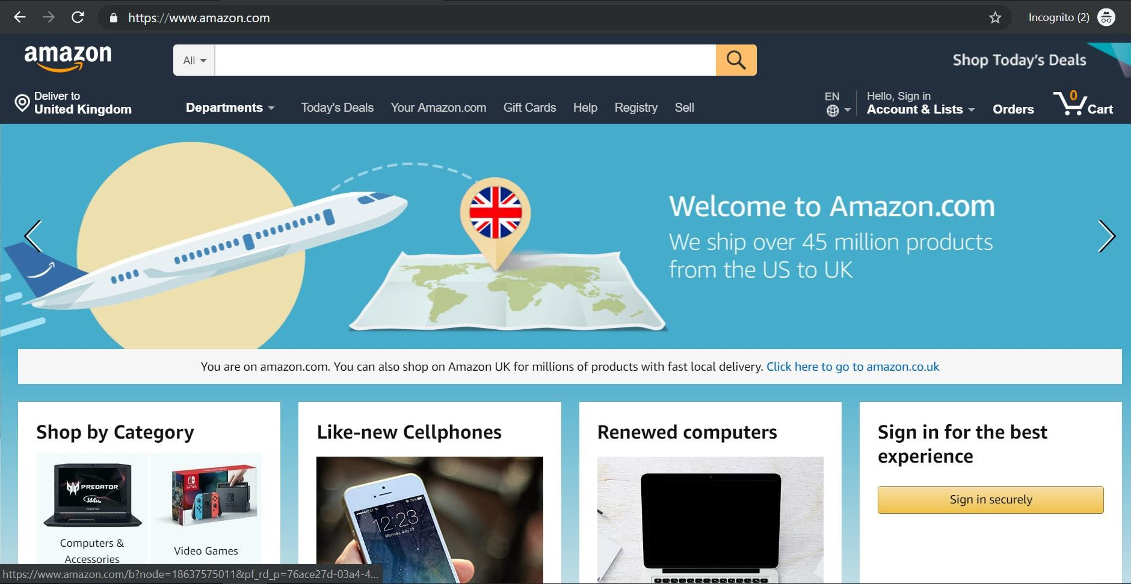
Interfaces
User Interface

Slide 4
Interfaces
Content-Type: application/json
Host: apigateway.us-east-1.amazonaws.com
X-Amz-Date: 20160531T184618Z
Authorization: AWS4-HMAC-SHA256 Credential={access_key_ID}/us-east- 1/apigateway/aws4_request, SignedHeaders=content-type;host;x-amz-date, Signature={sig4_hash}
GET /account HTTP/1.1
Application Interface

Slide 5
How It Works?
Users Management
Software
A P I
Orders Management
Software
Get user’s orders
Exposing an API

Slide 6
API Types
Operating System
Library
Remote
Web

Slide 7
Operating System API
OS (Windows / Linux / etc.)
My App
OS API
File System
Network Devices
User Interface Elements
Win32 API

Slide 8
Library API
My App
Logging API
Logging Library
Class Library
.NET
Java
Python
node.js
- …
Users
Library

Slide 9
Remote API
Users Component | Orders Proxy | Proprietary Protocol | Orders Component
 |  | Network
DCOM
.NET Remoting
Java RMI
- …
Same Platform

Slide 10
Web API
The Internet
My Web App
Web API
Weather Web App
Standard Protocol
Any Platform / OS
/ Language

Slide 11
Importance of API
Your API will be used:
By your UI
To extend your app’s reach
To allow monetization

Slide 12
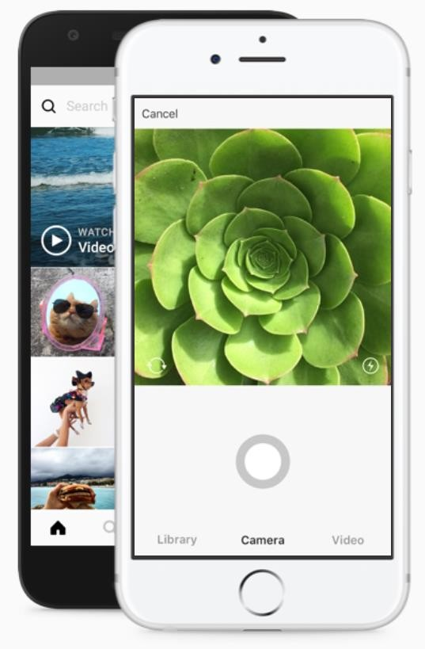
API For The UI
Modern apps are built for web and mobile
Mobile apps MUST have an API on the server in order to communicate with it
Web clients built using SPA also MUST have an API on the server

Slide 13
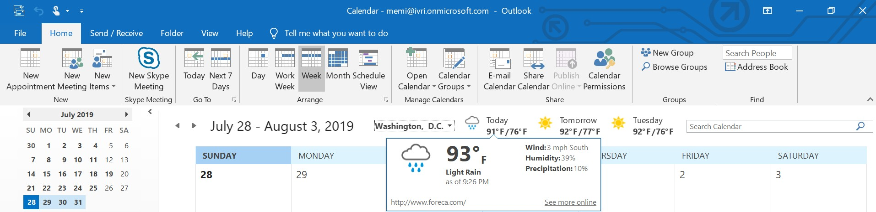
Extend Your Reach
By exposing API, other apps can use your data

Slide 14

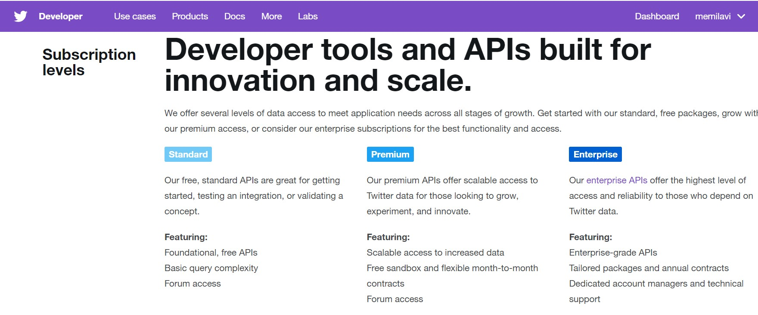
Monetize!
Charge for access for your data

Slide 15
Why Do You Need a Well-Designed API?

Slide 16
Your Developers Are Customers
They Have Alternatives
Your API Should Be Easy To Use and Consistent

Slide 17

Satisfied Customers => Less Support Calls

